Slide 1

MEDI-CAPS UNIVERSITY, INDORE
Department of Information Technology Engineering
PROJECT - FAKE NEWS DETECTION
Group Members:- Under The Guidence of :-
1. Sheikh Mohammed Sajid Mr. Sourabh Bhat
2. Sumit Sen
3. Sohan Khedekar

Slide 2

OUTLINE OF THE PRESENTATION
Abstract
Introduction
Problem Domain
Solution Domain
System Domain
Functional Requirement
Non Functional Requirement
Use Case Diagram
Activity Diagram
Application Domain
Expected Outcome
References

Slide 3
ABSTRACT
In recent years, due to the booming development of online social networks, fake news for various commercial and political purposes has been appearing in large numbers and widespread in the online world.
With deceptive words, online social network users can get infected by these online fake news easily, which has brought about tremendous effects on the offline society already
An important goal in improving the trustworthiness of information in online social networks is to identify the fake news timely.
The model will addresses the challenges introduced by the unknown characteristics of fake news and diverse connections among news articles, creators and subjects.
Extensive experiments have been done on a real-world fake news dataset to compare with news with several state-of-the-art models, and the experimental results have demonstrated the effectiveness of the proposed model.
1

Slide 4
INTRODUCTION
Fake news denotes a type of yellow press which intentionally presents misinformation or hoaxes spreading through both traditional print news media and recent online social media.
In this project, we propose to study the fake news detection problem in online social networks. Based on various types of heterogeneous information sources, including textual contents/descriptions and the article subject, we aim at identifying fake news from the online social networks simultaneously.
We took a news article dataset, we split the dataset to train and test data as the accuracy is calculated based on the test data. Implemented a TfidfVectorizer, initialized a PassiveAggressiveClassifier and Multinomial NB and fit our model.
Final outcome is to print out a confusion matrix to gain insight into the number of false and true negatives and positives.
2

Slide 5
PROBLEM DOMAIN
In this project, we propose to study the fake news detection problem in online social networks. Based on various types of heterogeneous information sources, including both textual contents/descriptions and the authorship and article subject relationships among them, we aim at identifying fake news from the online social networks simultaneously.
The authenticity of Information has become a longstanding issue affecting businesses and society
Fake news produce data that is big, incomplete, unstructured, and noisy
On social networks, the reach and effects of information spread occur at such a fast pace and so amplified that distorted, inaccurate or false information acquires a tremendous potential to cause real world impacts, within minutes, for millions of users
The increasing power that social media companies, such as Google, Apple, Facebook and Amazon, have gained in controlling who publishes what to whom, and how the publications are monetized.
3

Slide 6
SOLUTION DOMAIN
In this, a model is build based on the count vectorizer or a tfidf matrix ( i.e word tallies relatives to how often they are used in other artices in your dataset ) can help .
Since this problem is a kind of text classification, implementing a Multinomial Naive Bayes classifier will be best as this is standard for text-based processing.
The next step is to extract the most optimal features for countvectorizer or tfidf-vectorizer, this is done by using a n-number of the most used words, and/or phrases,
4

Slide 7
Tf-idf Vectorizer :-
TF (Term Frequency): The number of times a word appears in a document is its Term Frequency. A higher value means a term appears more often than others, and so, the document is a good match when the term is part of the search terms.
IDF (Inverse Document Frequency): IDF is a measure of how significant a term is in the entire corpus. The TfidfVectorizer converts a collection of raw documents into a matrix of TF-IDF features.
For a term t in a document d, the weight Wt,d of term t in document d is given by:
Wt,d = TFt,d log (N/DFt)
Where:
TFt,d is the number of occurrences of t in document d.
DFt is the number of documents containing the term t.
N is the total number of documents in the corpus.
5

Slide 8
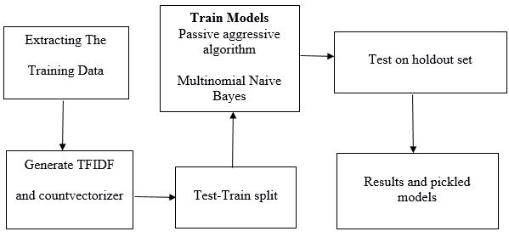
Fig 1.1 Flow of Implementation of Project
6

Slide 9
SYSTEM DOMAIN
Requirements :
Python : Python is an interpreted, high-level and general-purpose programming language.
Numpy : NumPy is a library for the Python programming language, adding support for large, multi-dimensional arrays and matrices, along with a large collection of high-level mathematical functions to operate on these arrays.
Pandas : pandas is a fast, powerful, flexible and easy to use open source data analysis and manipulation tool, built on top of the Python programming language.
Matplotlib :Matplotlib is a comprehensive library for creating static, animated, and interactive visualizations in Python.
Sklearn : Scikit-learn is a free software machine learning library for the Python programming language.
Pickel: Python pickle module is used for serializing and de-serializing python object structures.
Flask: Flask is a web application framework written in Python. Flask is based on Werkzeug WSGI toolkit and Jinja2 template engine.
7

Slide 10
FUNCTIONAL REQUIREMENT
The Functional Requirements are as follows:-
The system shall allow user to input the title or headline of the news article, text of the article and the subject.
The system UI contains a button which will execute the machine learning model on the basis of the input provided by the user.
The system shall display “Real” if the news provided by user is real news else shall display “Fake” if the news provided by user is fake news.
8

Slide 11
NON-FUNCTIONAL REQUIREMENT
Reliability Issue: To build the right model, and to predict or detect fake news but the work it would take to get the right training data.
Accuracy of the result: Our goal is to make a fake news detector with above 90% accuracy that uses machine learning.
Usability: The scope of the product is widespread. The only requirement is the input given as title, text and subject as a user. Besides, people from every age shall easily use the system.
Performance: We are aiming to make the system real-timed. In other words, the system should have enough speed that users of the system cannot realize the processing of data.
9

Slide 12
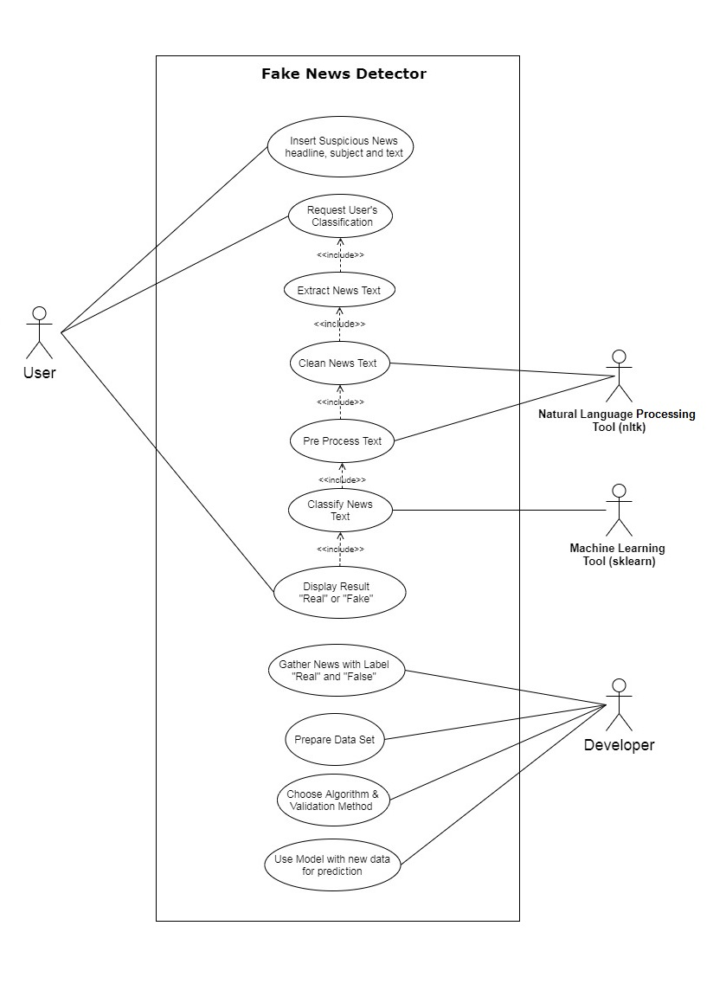
USE CASE DIAGRAM
10

Slide 13
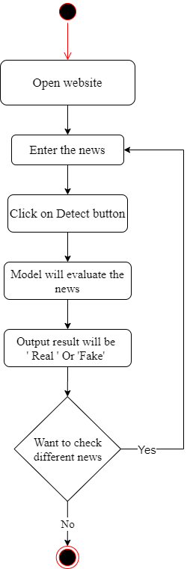
ACTIVITY DIAGRAM
11

Slide 14
APPLICATION DOMAIN
Fake news is a real problem, and part of the problem is that there aren’t enough humans to sit there and manually sift through every article to determine its genuineness. Through the use of this model, a user can test out a body text and see the probability that it is real, the probability that it is fake. It could also be useful in researches trying to develop improved models through the use of improved and enlarged datasets, different parameters, etc. The Model also provides a way to see manually how changes in the body text affect the classification.
12

Slide 15
EXPECTED OUTCOME
This is the kind of scale problem and a kind of text classification that machine learning is really good at solving. With the help of the model we want to stop the spread of misinformation and with the 94 % accuracy we have got with the model . Our model will be able to identify whether the news article is Fake or Real.
13

Slide 16
REFERENCES
[1]. Jiawei Zhang1, Bowen Dong2, Philip S. Yu. FAKEDETECTOR: Effective Fake News Detection, Department of Computer Science, Florida State University, FL, USA, 10 Aug 2019.
[2]. Simon Lorent. Fake News Detection Using Machine Learning, University Of Liege, Belgium, 2019
[3]. Hunt Allcott and Matthew Gentzkow. Social media and fake news in the 2016 election. In Journal of Economic Perspective, volume 31, 2017
[4]. Kai Shu , Amy Sliva , Suhang Wang , Jiliang Tang and Huan Liu. Fake News Detection on Social Media: A Data Mining Perspective, Computer Science & Engineering, Michigan State University, East Lansing, MI, USA 3 Sep 2017
[5]. Sohan Mone, Devyani Choudhary, Ayush Singhania. FAKE NEWS IDENTIFICATION CS 229: MACHINE LEARNING : GROUP 621, Stanford University, 2017
14

Slide 17

THANK YOU

